Slide 1
Events on a Shoestring Budget
Mrs. Shainy Edelman
Click Consulting Services

Slide 2
5 things to do when presenting
Talk slowly
Look at the audience
Don’t block the screen
Smile
Have fun!

Slide 3
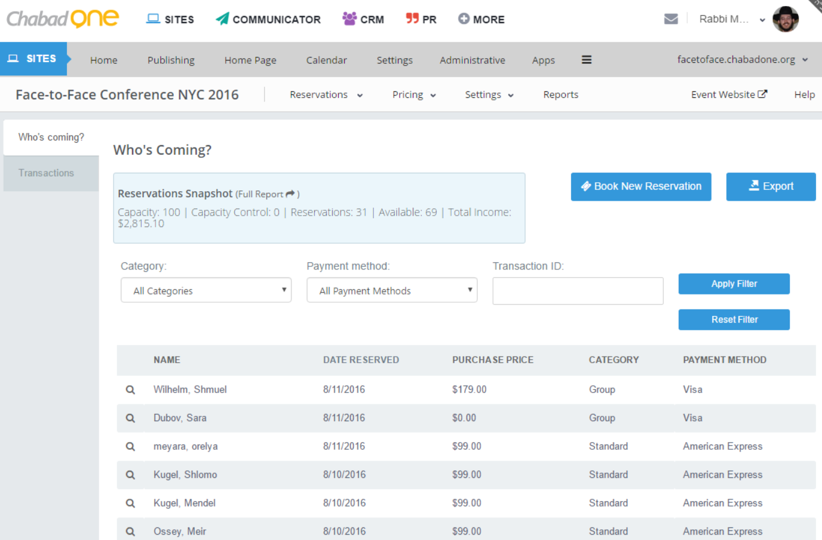
Display Screenshots Large

Slide 4
This is a comparison slide
Audio
Video
On the go
Multi-task
Less Expensive
More focused
Engaging
More expensive

Slide 5

DO include lots of graphics
They help keep things interesting

Slide 6
Up Next:
Going Mobile in Seven Easy Steps

